Slide 1
Decision Transformer with ViT State Encoder
Project by Akash

Slide 2
Overview
Decision Transformer is a decoder-only transformer architecture that aims to generate actions in an auto-regressive manner.
Learns from both expert and non-expert data thanks to reward conditioning.
Empirically proven to be significantly better than vanilla Behavior Cloning methods.

Slide 3
Goals
Train baseline DT, ViT-DT and MLP BC models on the dataset.
Tune CNN, ViT and MLP hyperparameters for optimal performance.
Run for 3 distinct Atari games: Breakout, Seaquest and Qbert.
Average the results over multiple runs with different seeds.

Slide 4
Dataset and Training
DT is primarily trained in an offline learning environment.
The agent is trained entirely on an existing dataset without any interaction with the environment.
Dataset consists of 200M frames or 50M (state, actions and rewards) experience tuples.

Slide 5
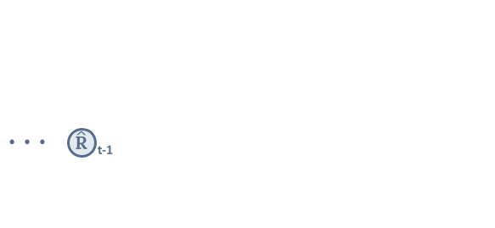
DT Architecture
Chen, L., Lu, K., Rajeswaran, A., Lee, K., Grover, A., Laskin, M., Abbeel, P., Srinivas, A., & Mordatch, I. (2021). Decision Transformer: Reinforcement Learning via Sequence Modeling. ArXiv. /abs/2106.01345

Slide 6
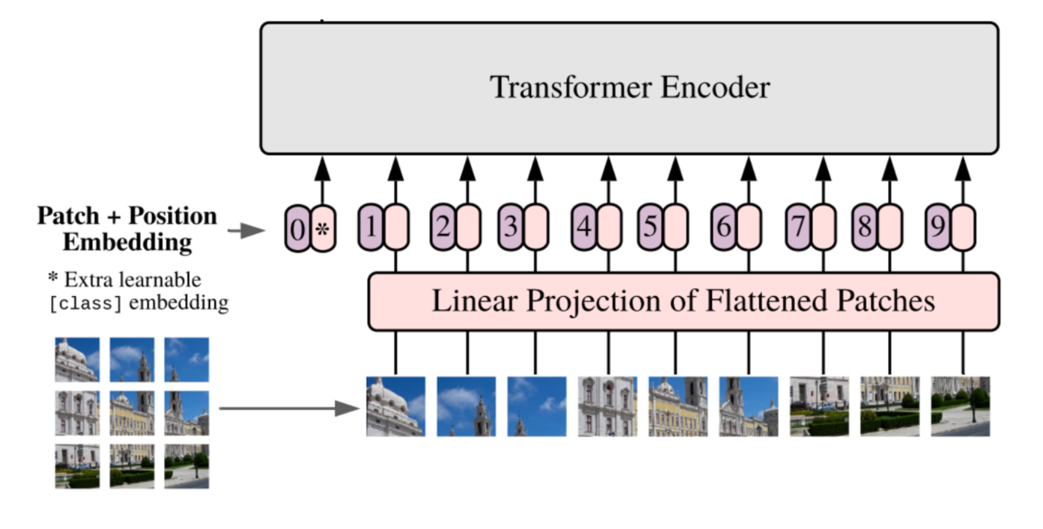
ViT State Representation
Dosovitskiy, A., Beyer, L., Kolesnikov, A., Weissenborn, D., Zhai, X., Unterthiner, T., Dehghani, M., Minderer, M., Heigold, G., Gelly, S., Uszkoreit, J., & Houlsby, N. (2020). An Image is Worth 16x16 Words: Transformers for Image Recognition at Scale. ArXiv. /abs/2010.11929

Slide 7
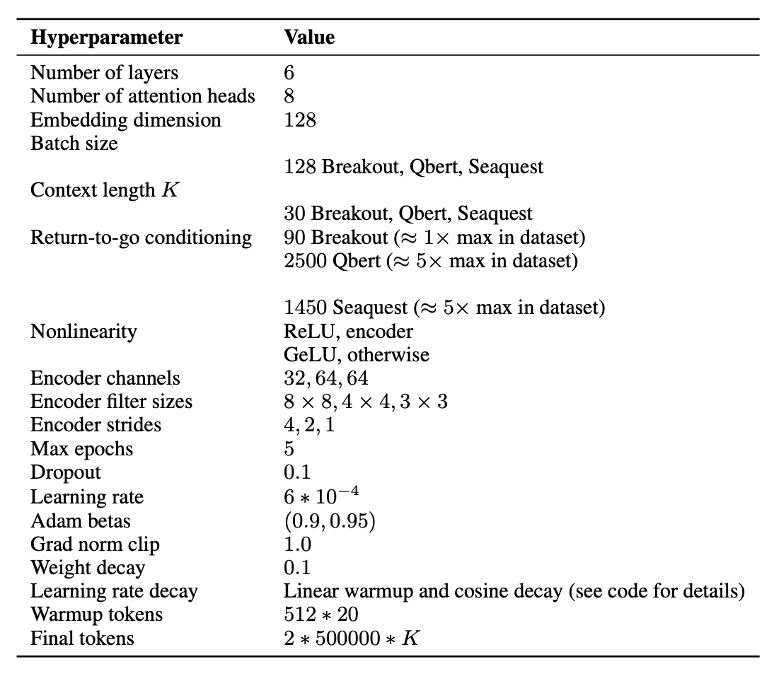
DT Configuration

Slide 8
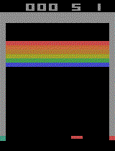
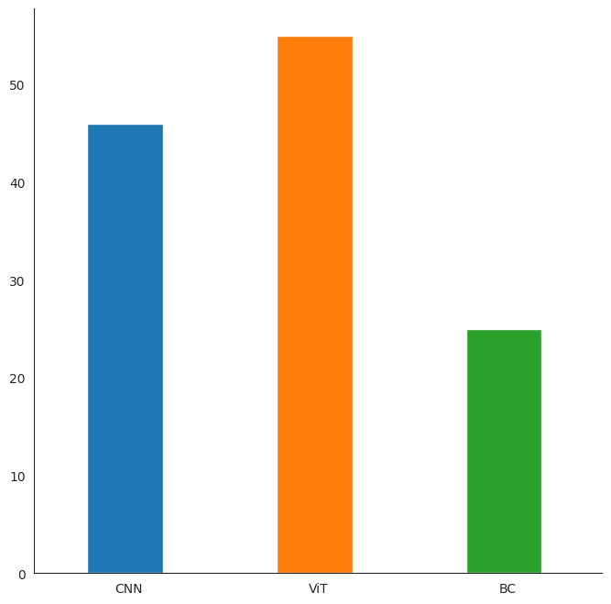
Breakout Results

Slide 9
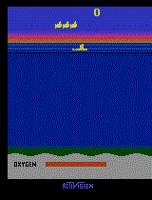
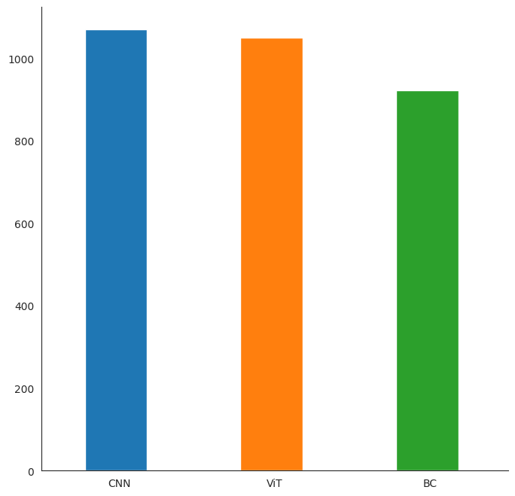
Seaquest Results

Slide 10
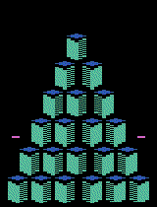
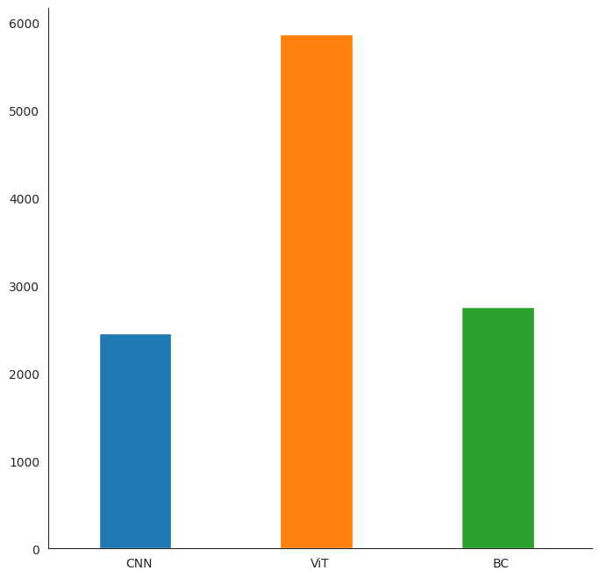
Qbert Results

Slide 11
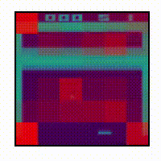
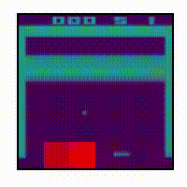
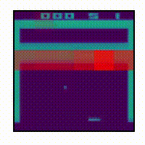
Breakout Attention Heads
Ball Free Move Space Unbroken Blocks
Lee, K., Nachum, O., Yang, M., Lee, L., Freeman, D., Xu, W., Guadarrama, S., Fischer, I., Jang, E., Michalewski, H., & Mordatch, I. (2022). Multi-Game Decision Transformers. ArXiv. /abs/2205.15241

Slide 12
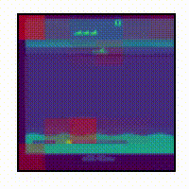
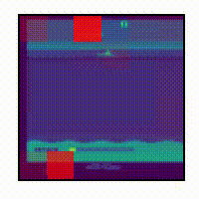
Seaquest Attention Heads
Player Bullets
Lee, K., Nachum, O., Yang, M., Lee, L., Freeman, D., Xu, W., Guadarrama, S., Fischer, I., Jang, E., Michalewski, H., & Mordatch, I. (2022). Multi-Game Decision Transformers. ArXiv. /abs/2205.15241

Slide 13
Further Developments
Multi-game pre-training of DT shows human-level performance: https://arxiv.org/abs/2205.15241
Online fine-tuning approach for DT that learns from replay rollouts (with hindsight experience replay): https://arxiv.org/abs/2202.05607
Prompting DTs to allow better generalization capabilities: https://arxiv.org/abs/2206.13499

Slide 14
Questions?

